Slide 1

Visual Environment, and Ecological Optics
CAP 5738 Data Visualization
Spring 2018
Dr. Sayeed S. Alam

Slide 2
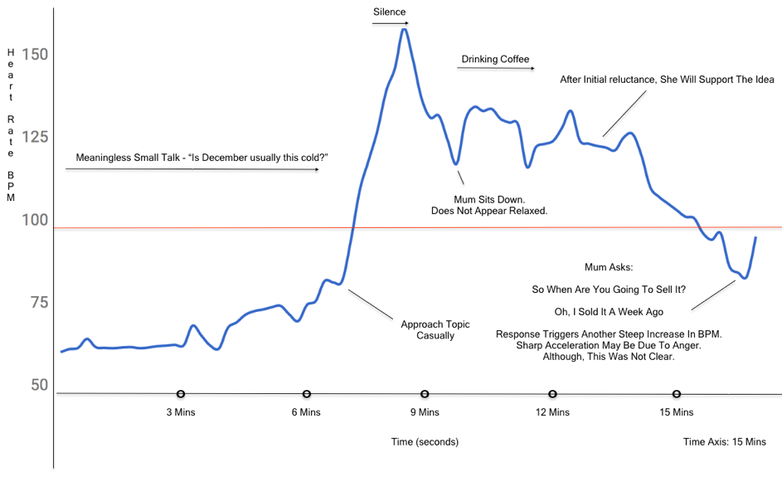
Today’s Visualization
“Mom! I sold my car!”
Ref: https://redd.it/7qle4d

Slide 3
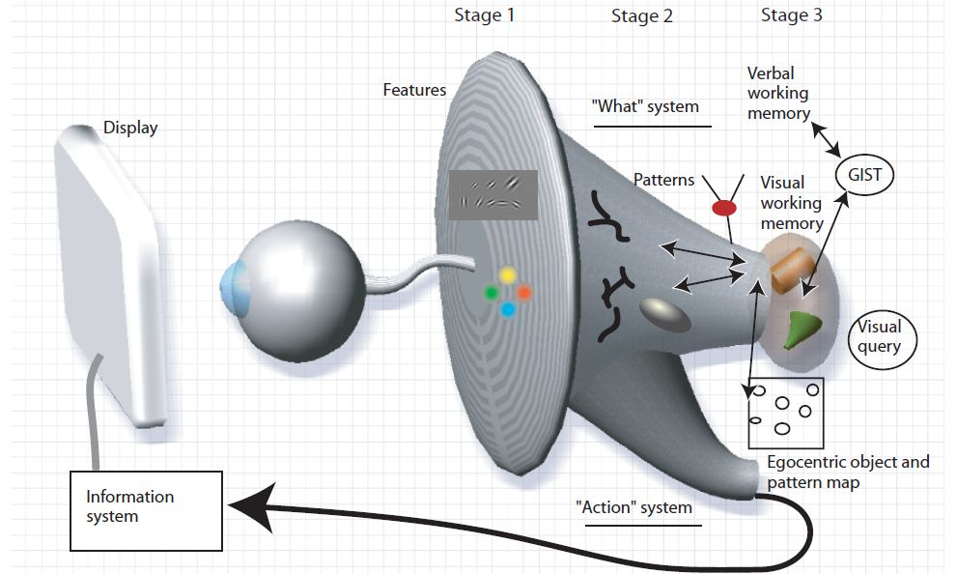
A Model of Perceptual Processing

Slide 4
Stage-1: Parallel Processing to Extract Low-Level Properties of the Visual Scene
Rapid parallel processing
Extraction of features, orientation, color, texture, and movement patterns
Transitory nature of information, which is briefly held in an iconic store
Bottom-up, data-driven model of processing

Slide 5
Visual Environment
A strategy for designing a visualization is to transform the data so that it appears like a common environment—a kind of data landscape.
The theory of evolution tells us that the visual system must have survival value, and adopting this perspective allows us to understand visual mechanisms in the broader context of useful skills, such as navigation, food seeking (which is like information seeking), and tool use (which depends on object-shape perception).

Slide 6
Visible Light
Perception is about understanding patterns of light.
Visible light constitutes a very small part of the electromagnetic spectrum.

Slide 7
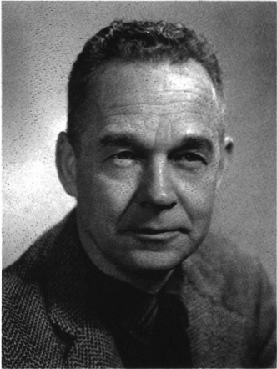
Ecological Optics
Developed by J. J. Gibson
Keys Concepts:
Perception of surfaces in the environment.
Ambient optical array
James J. Gibson

Slide 8
Surface vs Plane and Fiber vs Line
Surface is substantial; a plane is not. A surface is textured; a plane is not. A surface is never perfectly transparent; a plane is. A surface can be seen; a plane can only be visualized.
A fiber is an elongated object of small diameter, such as a wire or thread. A fiber should not be confused with a geometrical line.
In surface geometry the junction of two flat surfaces is either an edge or a corner; in abstract geometry the intersection of two planes is a line.

Slide 9
Affordances
A key function of the visual system is to extract properties of surfaces.
As our primary interface with objects, surfaces are essential to understanding the potential for interaction and manipulation in the environment that Gibson called affordances.
Affordance :
“the qualities or properties of an object that define its possible uses or make clear how it can or should be used “

Slide 10
Ambient Optical Array

Slide 11
Ambient Optical Array
From any particular stationary point in the environment, critical information is contained in the structure of the light arriving at that point.
This vast simplification is what Gibson called the ambient optical array.
This array encompasses all the rays arriving at a particular point as they are structured in both space and time.

Slide 12
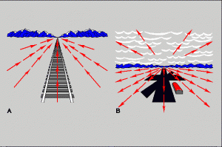
Optical Flow
Optic flow is information carried by light resulting from environmental structure and the animal’s path through the environment.

Slide 13
Textured Surfaces

Slide 14
Textured Surfaces
A surface is merely an unformed patch of light unless it is textured.
The texture of an object helps us see where an object is and what shape it has.
Texture can also be used to code information,

Slide 15
Shadings
Lambertian shading: A model for color diffusion
Specular shading: rendering glossy surfaces
Ambient shading: illuminating surfaces from everywhere.

Slide 16
Shadings

Slide 17
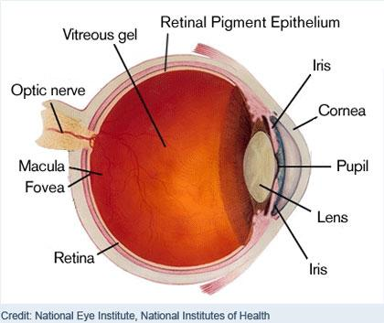
The Eye

Slide 18
Visual Angle

Slide 19
Visual Angle
1 cm object viewed at 57 cm has a visual angle of 1 minute

Slide 20
Lens
What will be the focal length of the lens when the object is at infinity?

Slide 21

Blind spot

Slide 22
Chromatic Aberration
Chromatic aberration means that different wavelengths of light are focused at different distances within the eye.
The human eye is not corrected for chromatic aberration.
Short-wavelength blue light is refracted more than long-wavelength red light.

Slide 23
Chromatic Aberration

Slide 24
Thank You

